Slide 1
Pythonic Prodigies Project 1
University of Utah AI Bootcamp
🌍 Brian Nelson, William Frescas, Trent Parker, Joe Middleton 🌎
Instructor- Jason Stewart, Teacher Assistant-Shay Schreurs
Thursday May 16th, 2024

Slide 2
Project Overview And Goals
Find the effect conflicts had on net migration for Rwanda, Afghanistan, Mexico, Iraq, Syria, Eritrea, Bosnia/Herzegovina, and Columbia.
Graph the conflict data, and also the data for the population changes, for each country.
Provide a summary analysis for the specific conflict events that impacted the overall population/migration.
Present the information to our class and Teacher/Teacher Assistant.
Discuss questions and answers as needed.
Notes:
Gathering our data from ourworldindata.org, our mission was to determine if there’s any correlation between conflict and migration in certain countries, regions, and continents.

Slide 3
What Qualifies as a Migrant? A Conflict?
What is a migrant (according to our data source, ourworldindata.org): An international migrant is someone who has been living for one year or longer in a country other than the one in which they were born.
What is a conflict (according to our data source, ourworldindata.org): There are six separate source materials used to collect information. Each source has their own perspective on what is considered a conflict. Some won’t consider it a conflict unless there are at least 500 to 1,000 deaths. Others consider a minimum of 25 deaths a conflict death. A conflict death can be considered if the death was during an ‘armed conflict, ‘conventional war’, ‘militarized confrontation’, or a ‘violent political conflict.’ While all groups consider dying on the battlefield a ‘conflict death,’ some sources also take into account civilian deaths as a result of starvation and/or disease.
Data was collected from these six separate source materials:
Uppsala Conflict Data Program (UCDP)
Project Mars by Jason Lyall (2022)
Militarized Interstate Events by Douglas Gibler and Steven Miller
Correlates of War (CoW)
Peace Research Institute Oslo (PRIO)
Conflict Catalog by Peter Brecke (1999)
Notes:
Before we go over our results we need to define what’s considered a migrant and a conflict. A migrant is when an individual is living in another country for at least one year. Data for a conflict comes from 6 seperate sources. These sources characterize and armed conflict, conventional war, and military confrontation as conflicts. Conflict deaths are not considered in some case until there are as many as 500 or 1,000 deaths, and some as little as 25. Some sources consider starvation and disease as a conflict death.

Slide 4
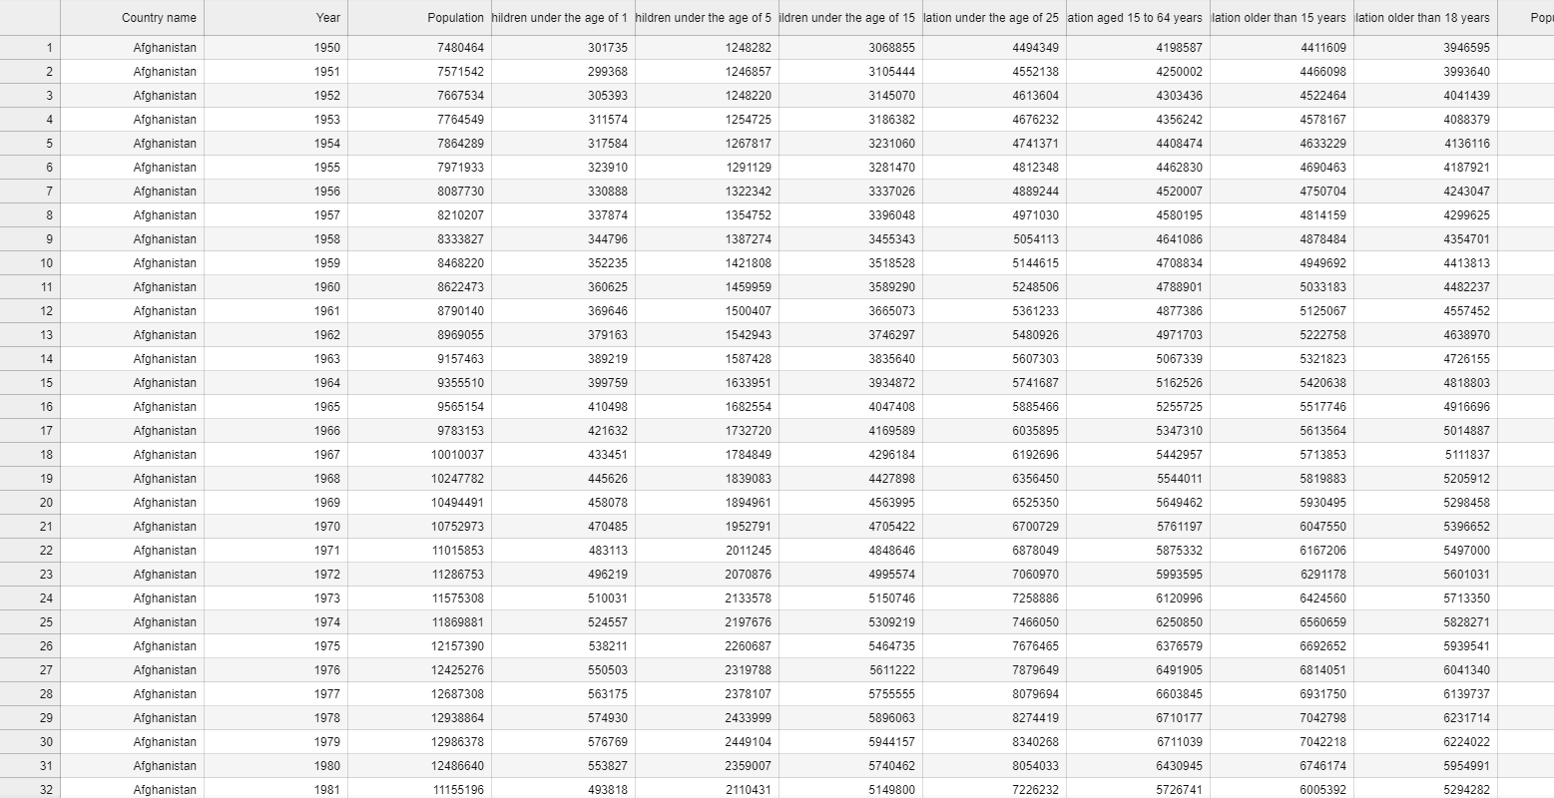
Datasets and Process
Population CSV
Notes:
We pulled all of our datasets from ourworldindata.org. This is our population dataset. Since we were only concerned with the overall population, once the csv was read into jupyter lab we filtered to only show the population column, we also had to slice the dataframe to show only 1989 - 2021 to match up with our conflict realted deaths dataset.

Slide 5
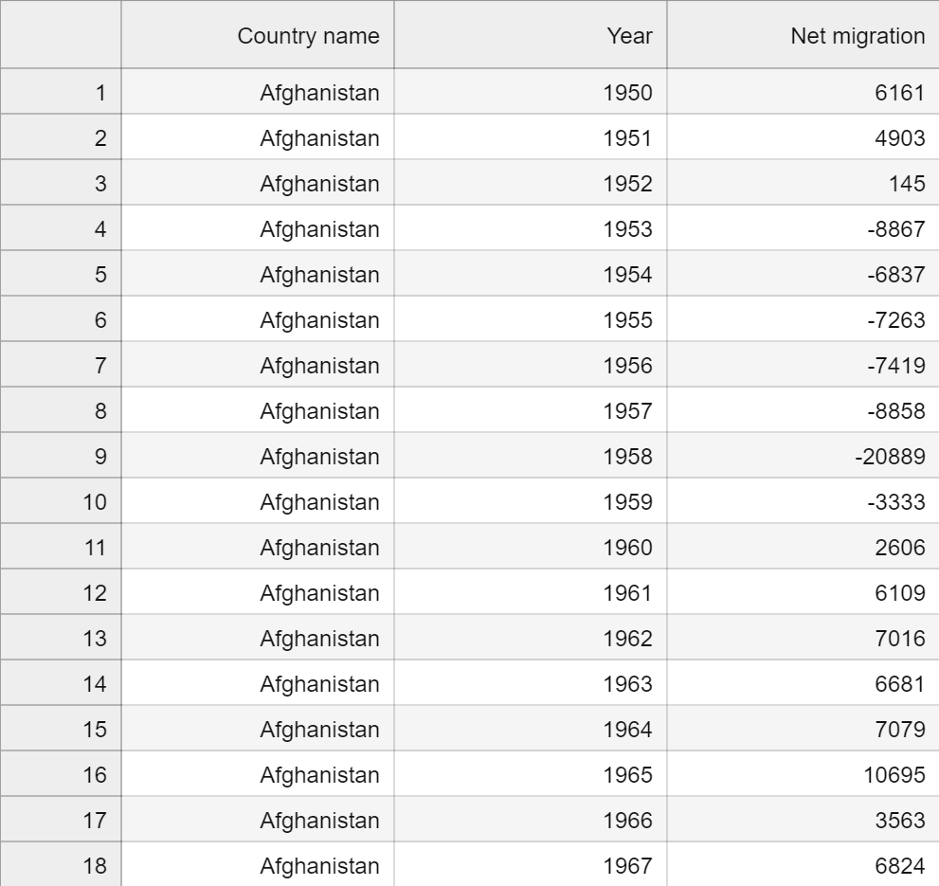
Datasets and Process
Migration CSV
Notes:
This is the dataset we used for looking at net migration in our selected countries. We also had to slice this dataframe to show 1989-2021 to match up with our conflict related death data.

Slide 6
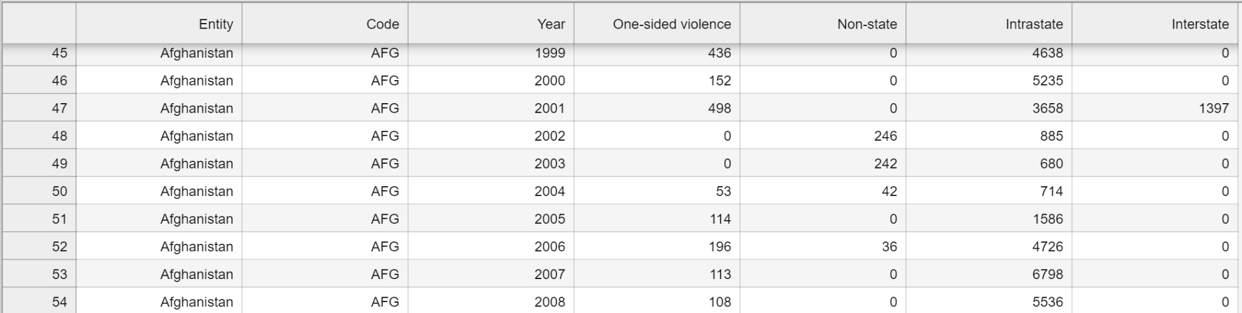
Datasets and Process
Conflict Related Deaths CSV
Notes:
This is the dataset we used to look at conflicted related deaths. You can see that there were many different categories for these deaths, so we simply summed these into one category for overall conflict related deaths

Slide 7
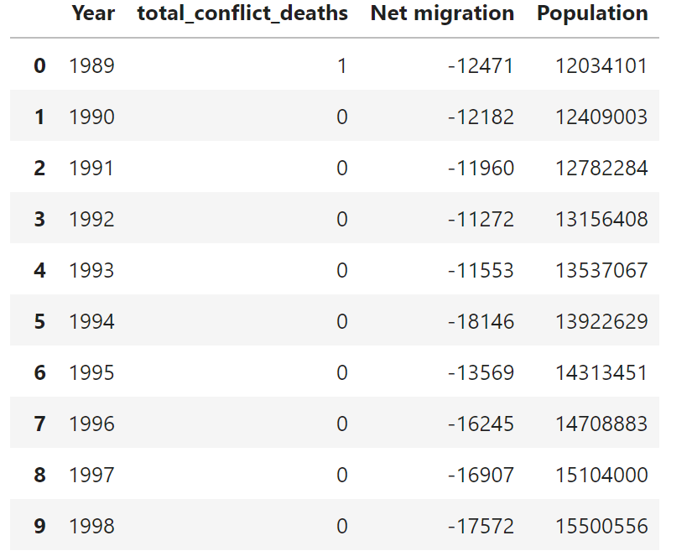
Datasets and Process
Conflict Deaths, Migration, and Population Dataframe
Notes:
This is what the dataframe we used to plot the graphs looked like after merging the dataframes. After getting the years we needed, the summed deaths, and the overall population columns isolated, it was easy to select which columns we wanted to plot. Some of the numbers were a bit mismatched compared to population, so we had a hard time graphing all 3 lines on a dual y axis plot. For these, we simply put population on its own graph so we could still compare the graphs side by side.

Slide 8
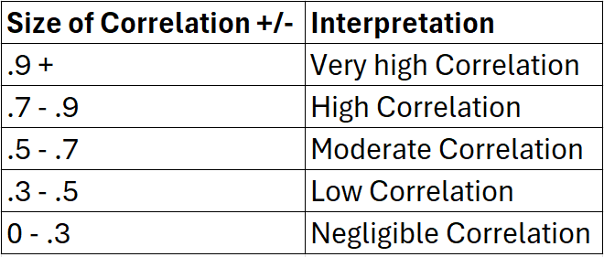
Interpreting Correlation Coefficient

Slide 9

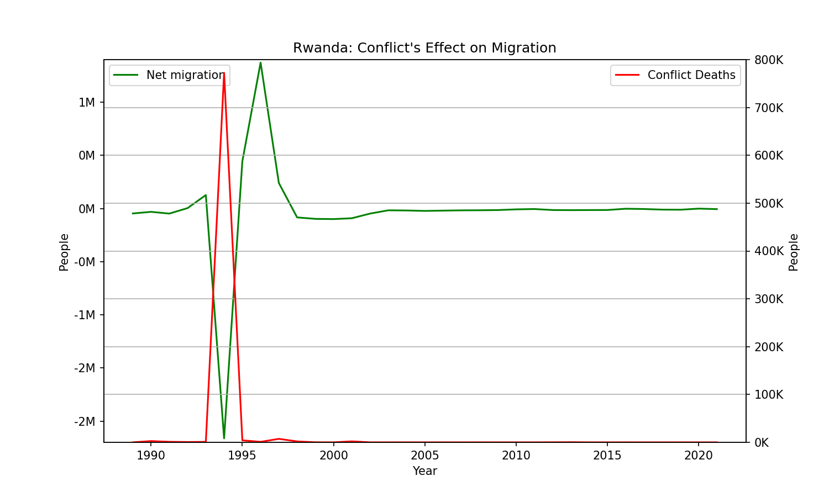
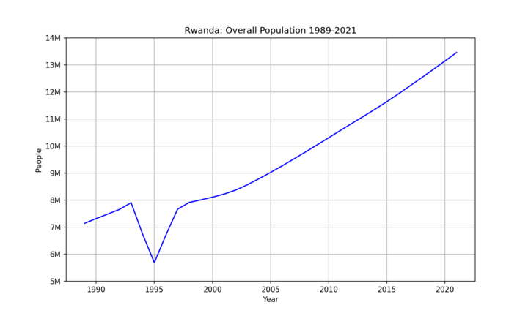
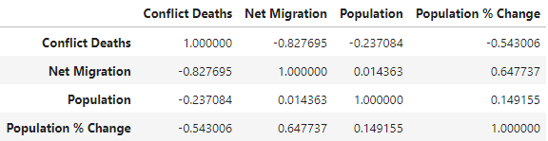
Rwanda: Conflict Deaths, Migration, and Population
Notes:
As you can see, when conflict deaths skyrocketed in 1994, net migration plummeted, meaning people were leaving the country. You can see the impact in the overall population as well. The correlation between net migration and conflict deaths for rwanda during this time period is -0.8, which is a high correlation. This pretty much means that in Rwanda, whenever conflict death is high, net migration is low.
Rwandan Genocide (1994): Rwanda experienced a devastating genocide, which resulted in a large number of conflict-related deaths. The genocide was primarily perpetrated by extremist Hutu militias against the Tutsi ethnic group, as well as moderate Hutus who opposed the genocide. During the genocide, an estimated 800,000 to 1 million people, primarily Tutsis, were killed over a period of about 100 days.

Slide 10

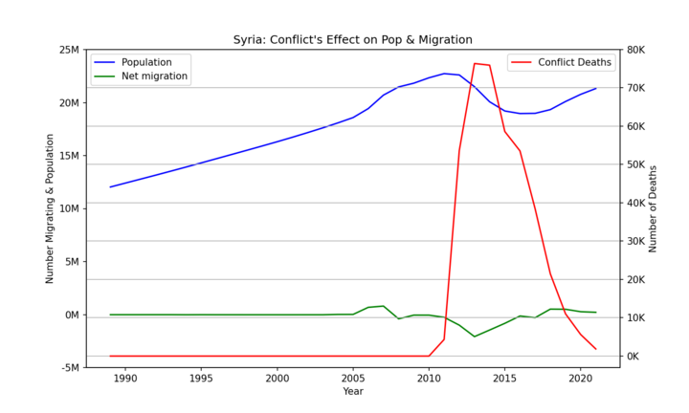
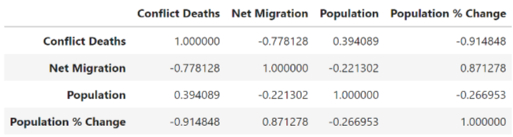
Syria: Conflict Deaths, Migration, and Population
Notes:
Syrian Civil War (2011-present): The Syrian Civil War began in 2011 as a popular uprising against the authoritarian regime of President Bashar al-Assad. The conflict quickly escalated into a full scale war, resulting in hundreds of thousands of deaths and millions of people displaced internally and externally.

Slide 11

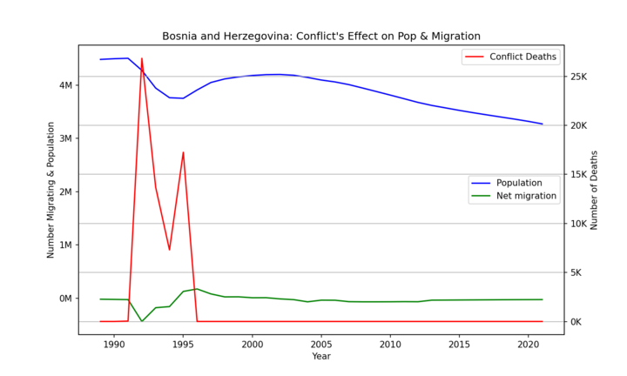
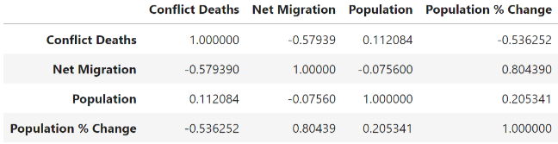
Bosnia/Herzegovina:Conflict Deaths, Migration, and Population
Notes:
Bosnia and Herzegovina experienced one of the most devastating conflicts in Europe since World War II. The Bosnian War (1992-1995), was a tragic and complex conflict that resulted in a staggering loss of life, displacement of populations, and long-lasting trauma for the people of Bosnia and Herzegovina. The effects of the war continue to be felt in the country's social, political, and economic landscape.

Slide 12

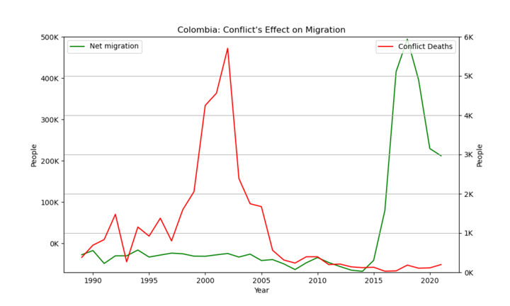
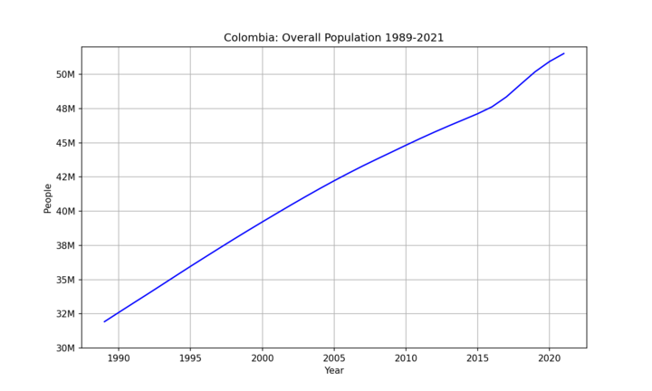
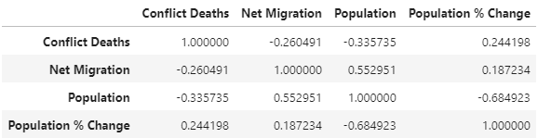
Columbia: Conflict Deaths, Migration, and Population
Notes:
The Colombian Drug War (late 1980s-2000s) between powerful drug cartels such as the Medellín and Cali Cartels lead to widespread violence, bombings, and turf wars. The Colombian government security forces intervened and engaged in a prolonged battle resulting in considerable bloodshed and deaths. The Revolutionary Armed Forces of Colombia long running insurgency against the Colombian government resulted in significant casualties among civilians, combatants, and security forces, with widespread displacement of populations.

Slide 13

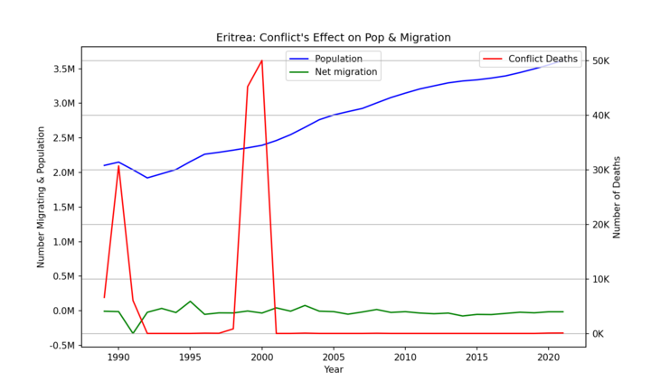
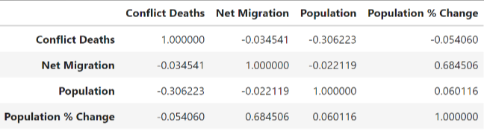
Eritrea: Conflict Deaths, Migration, and Population
Notes:
Eritrean War of Independence (1961-1991): While the Eritrean War of Independence officially began in 1961, it continued into the late 1980s and early 1990s. The conflict resulted in significant loss of life and destruction and led to widespread displacement of populations
Eritrea-Ethiopia Border Conflict (1998-2000): In 1998, a border dispute between Eritrea and Ethiopia escalated into full-scale war, and resulted in tens of thousands of casualties on both sides.

Slide 14

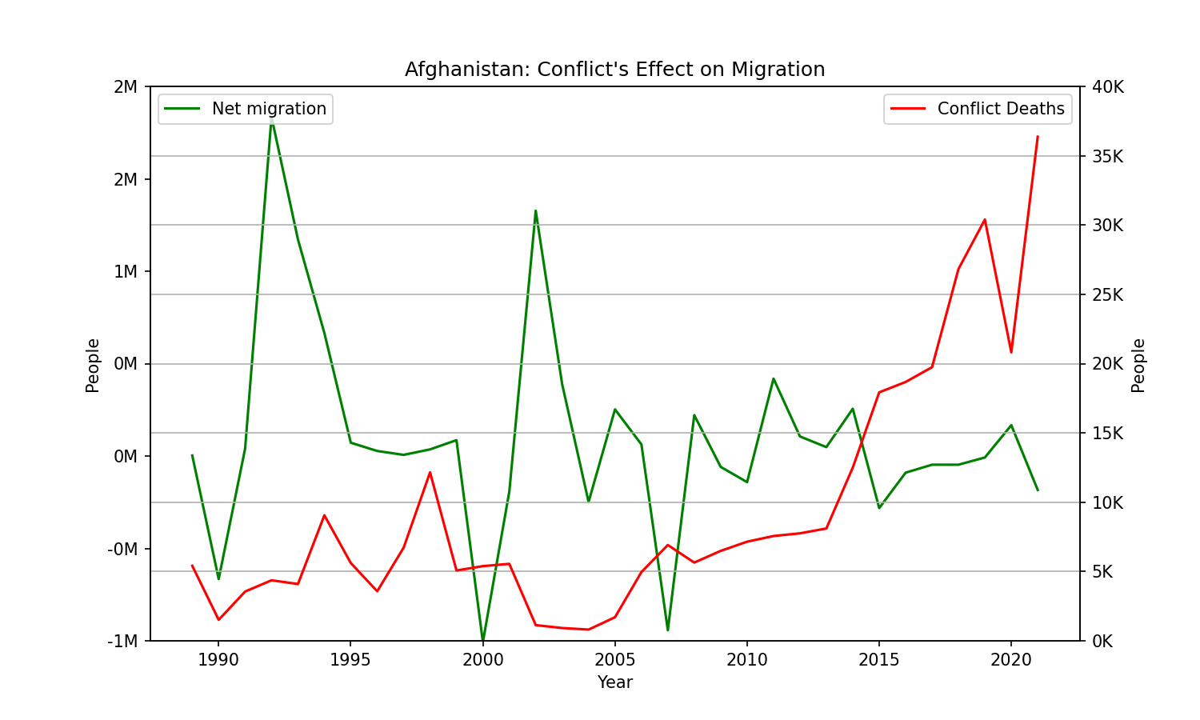
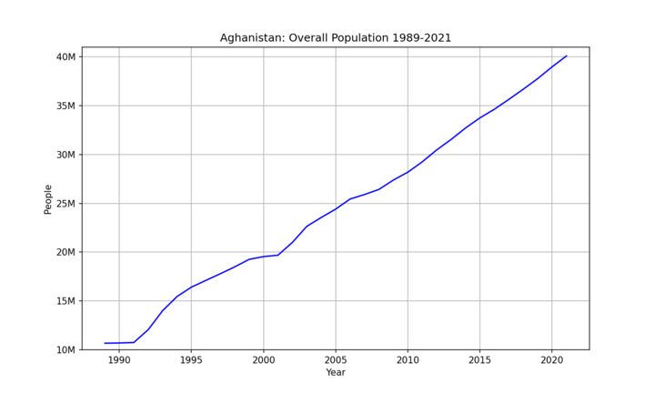
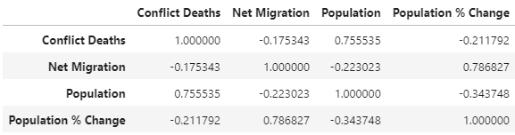
Afghanistan: Conflict Deaths, Migration, and Population
Notes:
Rise of ISIS-Khorasan (2015-present): The Islamic State of Iraq and the Levant (ISIS) established a branch in Afghanistan known as ISIS-Khorasan Province (ISIS-K). The group has carried out numerous attacks targeting civilians, security forces, and religious minorities. ISIS-K's activities have further fueled violence and instability in the country.

Slide 15

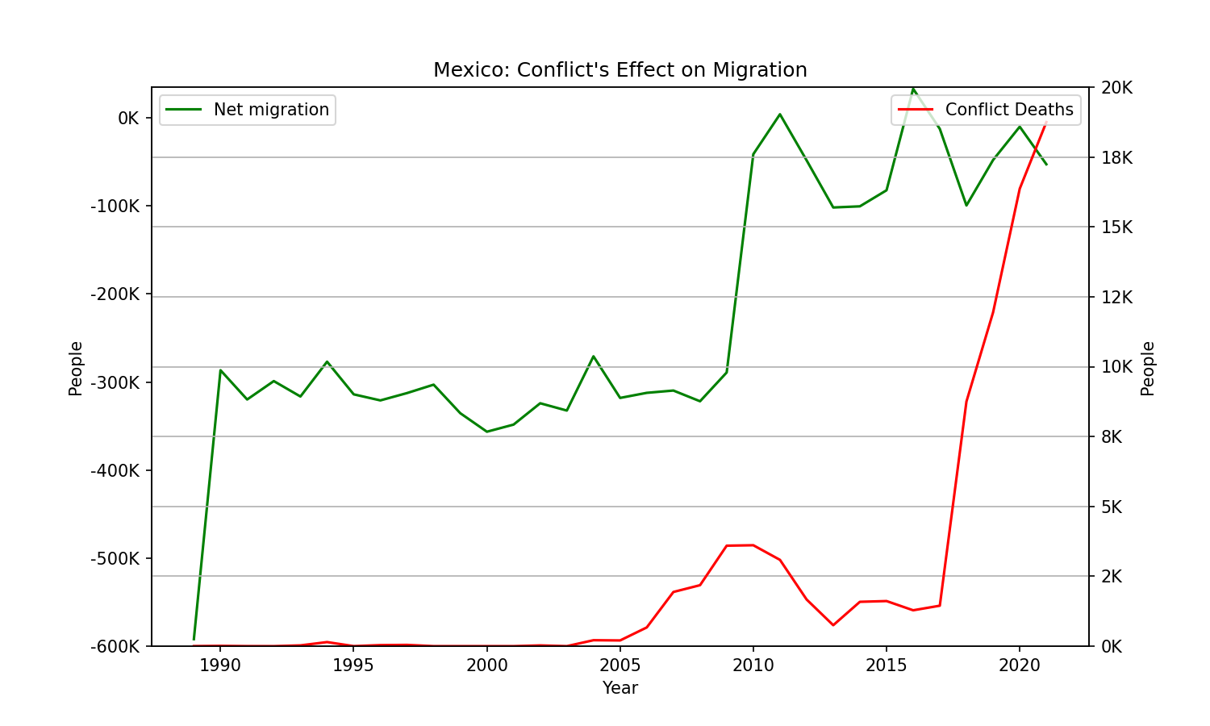
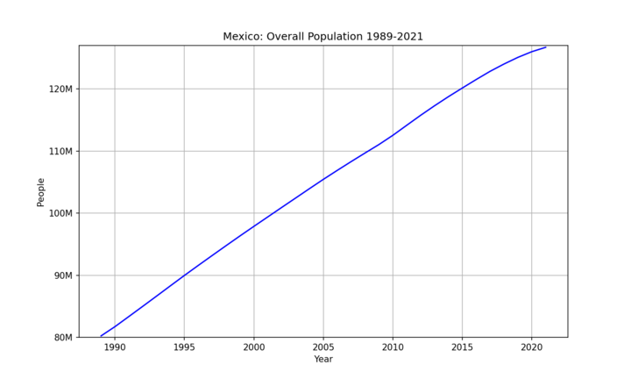
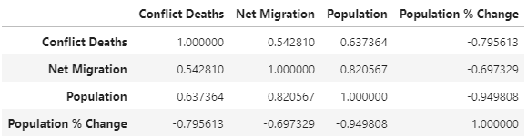
Mexico: Conflict Deaths, Migration, and Population
Notes:
Drug War (2006-present): Mexico's drug war escalated significantly in 2006 when the government launched a military-led crackdown on drug cartels and organized crime groups. The conflict has involved widespread violence, including shootings, assassinations, and turf battles between rival cartels. Tens of thousands of people, including civilians, law enforcement officers, and cartel members, have been killed in the violence.

Slide 16
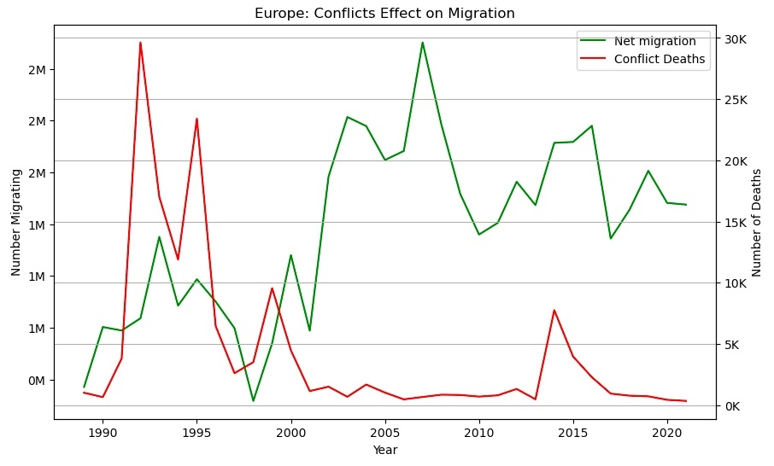
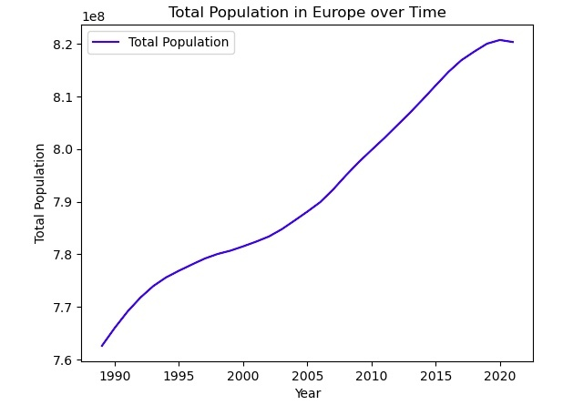
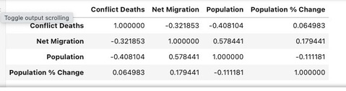
Europe

Slide 17
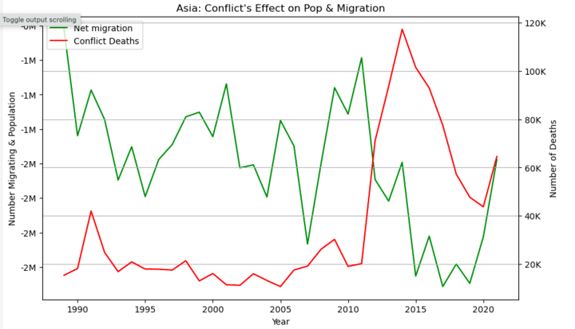
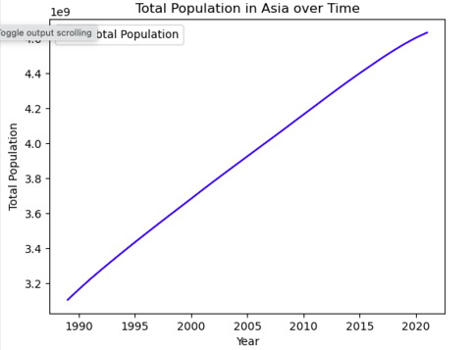
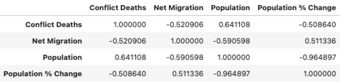
Asia

Slide 18
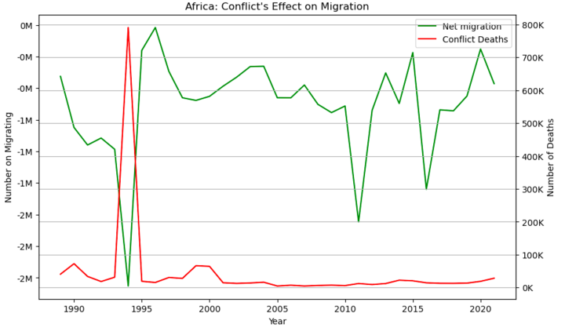
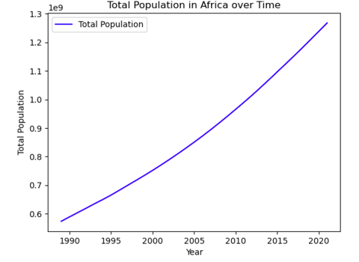
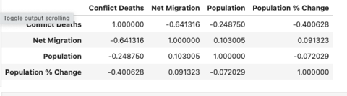
Africa

Slide 19
Analysis and Conclusion
In conclusion, the analysis of population, net migration, and conflict deaths datasets across specific countries from 1989 to 2021 revealed migration patterns that seem to be influenced by various factors, not just conflict related deaths. While countries like Rwanda, Syria, and Bosnia displayed a strong negative correlation between conflict deaths and net migration, indicating significant outward migration in response to conflict, Mexico emerged as an exception with a moderate positive correlation. This highlights the complexity of migration patterns and the multitude of factors influencing migration decisions, beyond conflict alone. Further research is warranted to explore the unique contextual factors shaping migration dynamics in each country and region, as well as to identify additional exceptions to observed trends.

